Slide 1
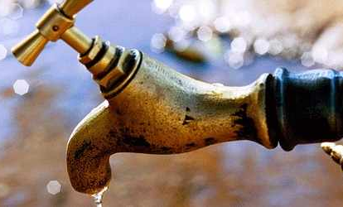
«Water Sector Reform in Kenya »
Trainings 24.-28.8. and 28.9.-2.10.2015

Slide 2
Definitions in Sanitation
Based on „Sector Governance in Urban Sanitation“ e-learning course of Margraf Publishers

Slide 3
Table of Content
  Sanitation
  Hygiene
  Improved Sanitation
  Imprtant messages
  Centralized and decentralized sanitation

Slide 4
Sanitation
  aims to remove and dispose of human waste (excreta and urine) and wastewater in such a way
  that it creates convenience and privacy for the users,
  and creates a hygienic environment
  which reduces the risks of pathogen transmission from human waste.

Slide 5
Hygiene comprises the following issues:
  Safe water storage and handling of water
  Safe hand washing practices
  Safe treatment of food stuffs
  Safe storage of human and household "waste"
  «Sanitation» and «Hygiene» are two different issues!

Slide 6
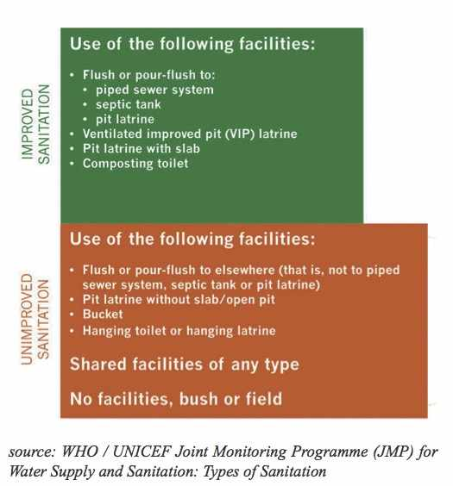
Improved Sanitation
Notes:
The term “improved sanitation” and "unimproved sanitation"
has been used in the MDGs and defined by the Joint Monitoring Programme of WHO/UNICEF and includes (see graph on the right):
»Excreta disposal systems are considered adequate, if they are private and if they separate human excreta from
human contact« (JMP = Joint Monitoring Programme, 2005)

Slide 7
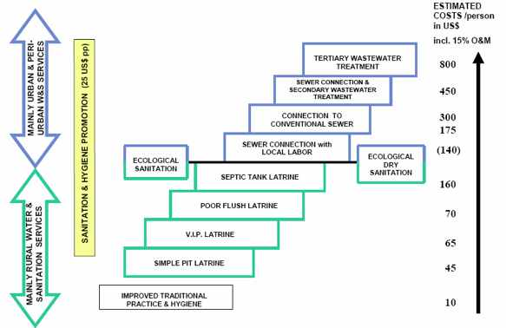
Sanitation ladder

Slide 8
Important messages regarding sanitation:
  The Sanitation crisis is above all due to a governance problem
  Sanitation is in “a state of emergency”
  There is no unique or miracle solution...
  Rule of the "3 A”
    Availability (providers)
    Affordability (price)
    Accessibility (location)
  The Sanitation sector is a very complex one
Notes:
1 - Achieving the eight MDGs (Millenium Development Goals) depends strongly on enhancing water and sanitation governance.
2 - Regarding the scale of the sanitation crisis and its negative impact on a number of social and economic sectors and also on water resources in terms of pollution.
3 - ...for the multiple and various situations of inadequate sanitation. It is necessary to fully consider plausible sanitation options that may suit a concrete situation. In some cases, it could be wise to “swim against the tide”.
4 – Complex because : It is not only a technical question; it deals at first with political, financial, social and cultural aspects and also involves urban and land use planning.

Slide 9
  Centralized sanitation
  In general, centralized conventional urban sanitation systems consist of:
  Collection and transport of wastewater and stormwater through combined or separate sewers
  Treatment of the waste water and sludge (Waste Water Treatment Plant)
  Treatment of stormwater.

Slide 10
  Conventional decentralized sanitation
  On-site or individual sanitation systems have been used for centuries to provide excreta disposal at the household level. There are two basic types:
  Dry systems: simple pit latrine (unimproved), covered pit latrines and Ventilated Improved Pit latrines (VIP).
  Water based systems: pour-flush latrine (single or double pit), pour-flush toilet to a septic tank

Slide 11
  DTF
  What is DTF in the context of sanitation?
  Is it centralized or decentralized?
  Which elements does it consist of?
  What is the input, what is the output?
  .......

